Slide 1
Smart Desk Lamp: Prototype Presentation
A4 Group 7: Michelle, Kevin, Parthi & Justen

Slide 2
Problem Statement
Our
To design a smart desk lamp, catering to those with cognitive disabilities and limited mobility, to decrease the negative effects of blue light.

Slide 3
Key Objectives & Metrics
01
02
03
04
05
Reliable
Emits Light
Accessible
Effects of blue light
Self adjusts
Works 99% of the time
380-700 nm
Large Surface Area for sensing ~4 sq. inches
>580 nm during night
Wavelength - Time
Brightness- Lux

Slide 4
Key Objectives & Metrics- Cont.
06
07
08
09
10
Safe
Durable
Affordable
Lightweight and Portable
Adjustable
< 40℃,
Topple limit > 60°
Lifespan- 5 years
< $250
180° rotating hinge 30-90° hinge on base, symmetric
<15lbs

Slide 5
Key Parts
01
02
03
04
Touch
sensor
Light
sensor
Real-Time
Clock
LED
Matrix
Force Sensitive Resistor (FSR)
Acts as a toggle switch
Broad sensitivity (0.1-10kg)
BH1750
1-65535 lux
Small Measurement Variation (+/- 20%)
DS3231
Automatically adjusts and self-corrects
Has a built in battery
Beam angle- 120
Life > 50k hours
Programmable wavelength and brightness

Slide 6
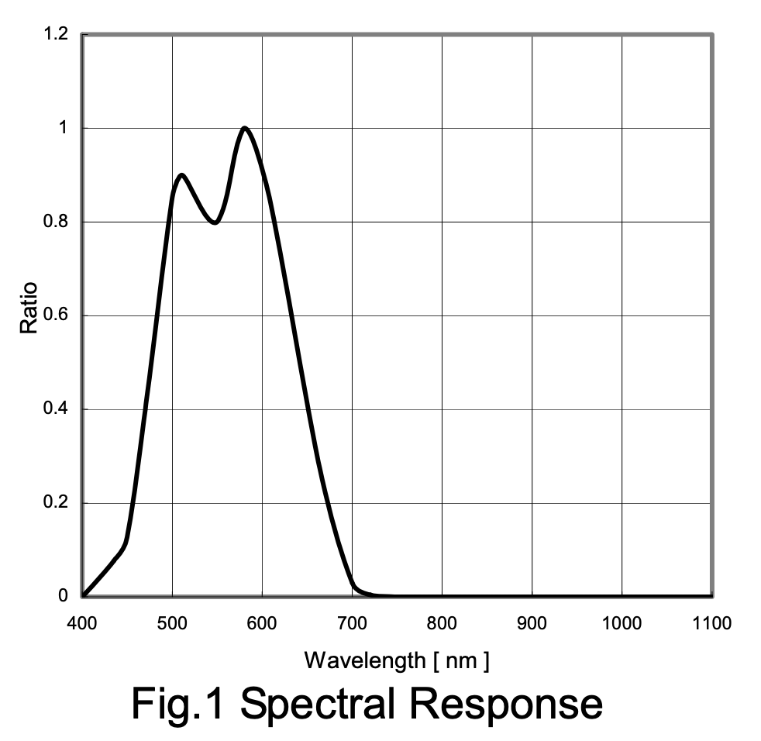
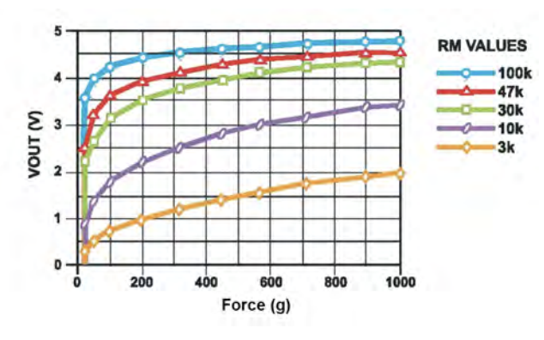
Key Parts- Visualisation
Fig 1.1: Spectral Response of BH1750 (Sensitivity of sensor to optical radiation of different wavelengths
Fig 1.2: Force vs Vout of FSR using diff resistors. Can be manipulated to make it more sensitive so it is accessible to our user group

Slide 7
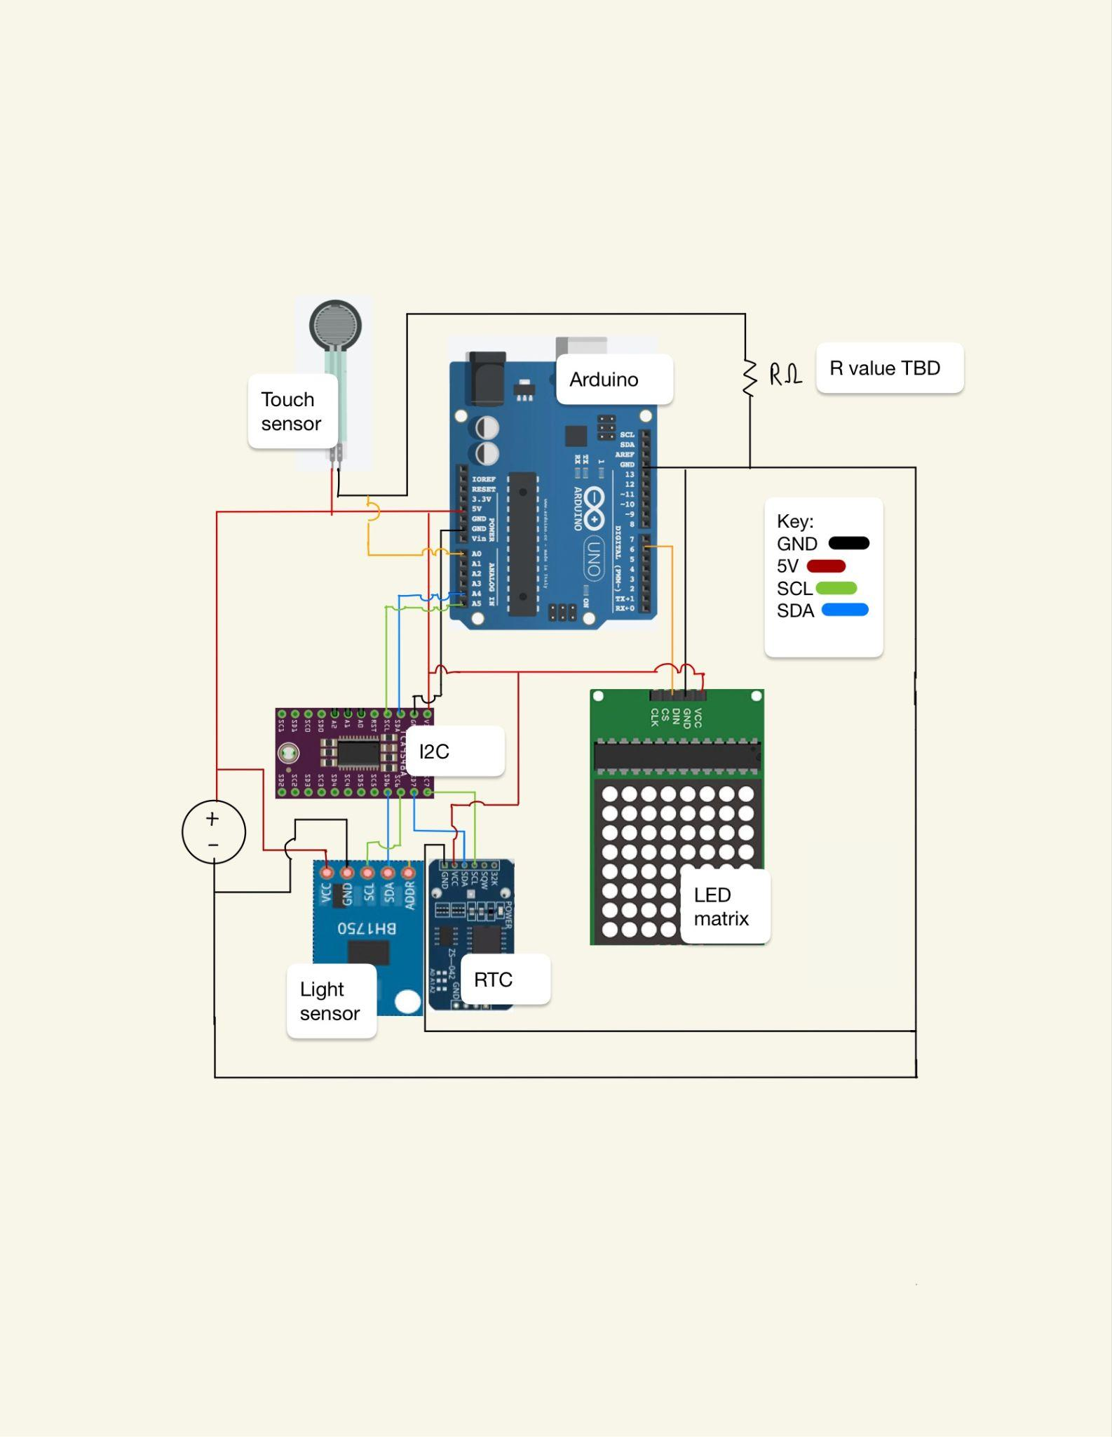
Circuit Diagram and Wiring
I2C multiplexer allows us to connect both our sensors to the arduino
Both require a connection to SDA and SCL
R value dependent on sensitivity required:
Detects touch only when intended
Accessible to user group
Fig 2.0: Circuit diagram

Slide 8
User groups- Plans on inclusivity
ALS, Arthritis, Senior citizens:
No use /need to change batteries
Sensitive touch sensor
Self- Adjusting
Cater to those with cognitive disabilities and limited mobility
Easy to use for age groups 5 - 105 years
Reducing blue light emissions:
Circadian rhythm
Increasing focus for those with ADHD
Lamp can be used almost anyone:
Helps regulate sleeping disorders using warm light

Slide 9
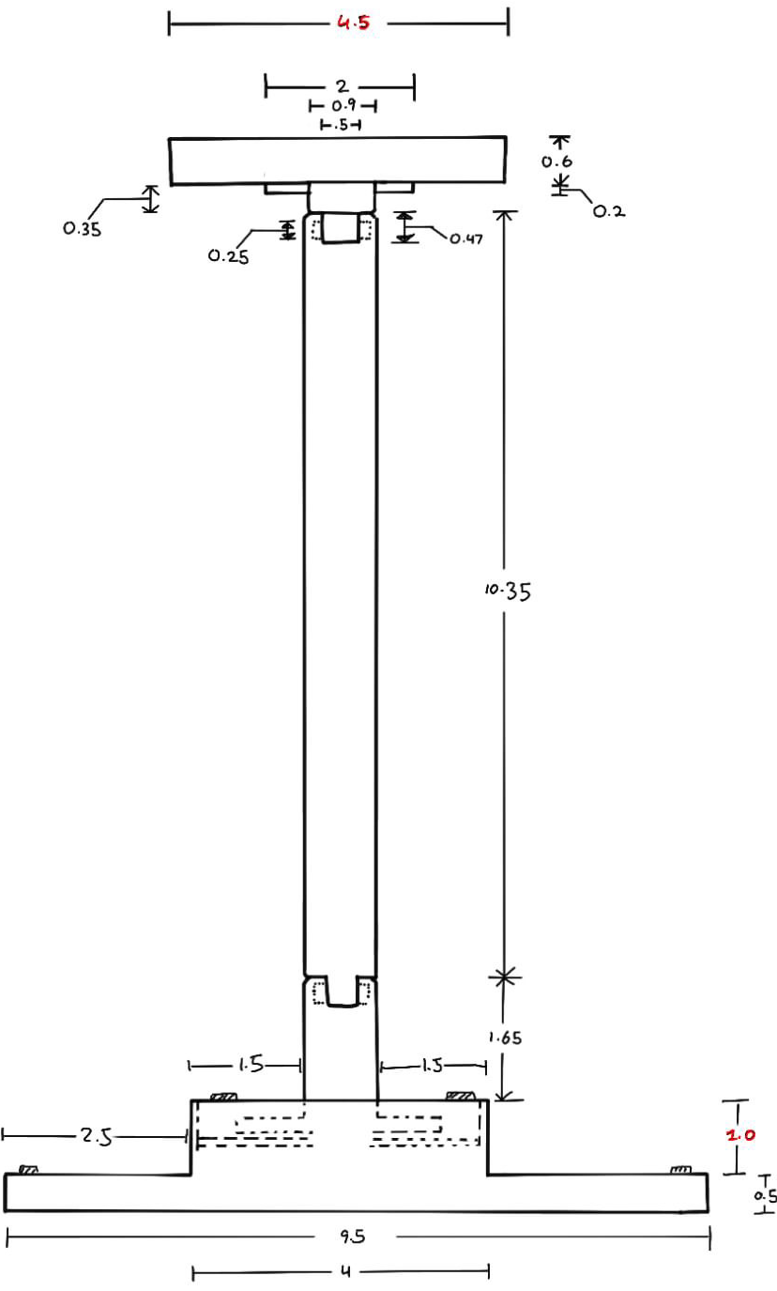
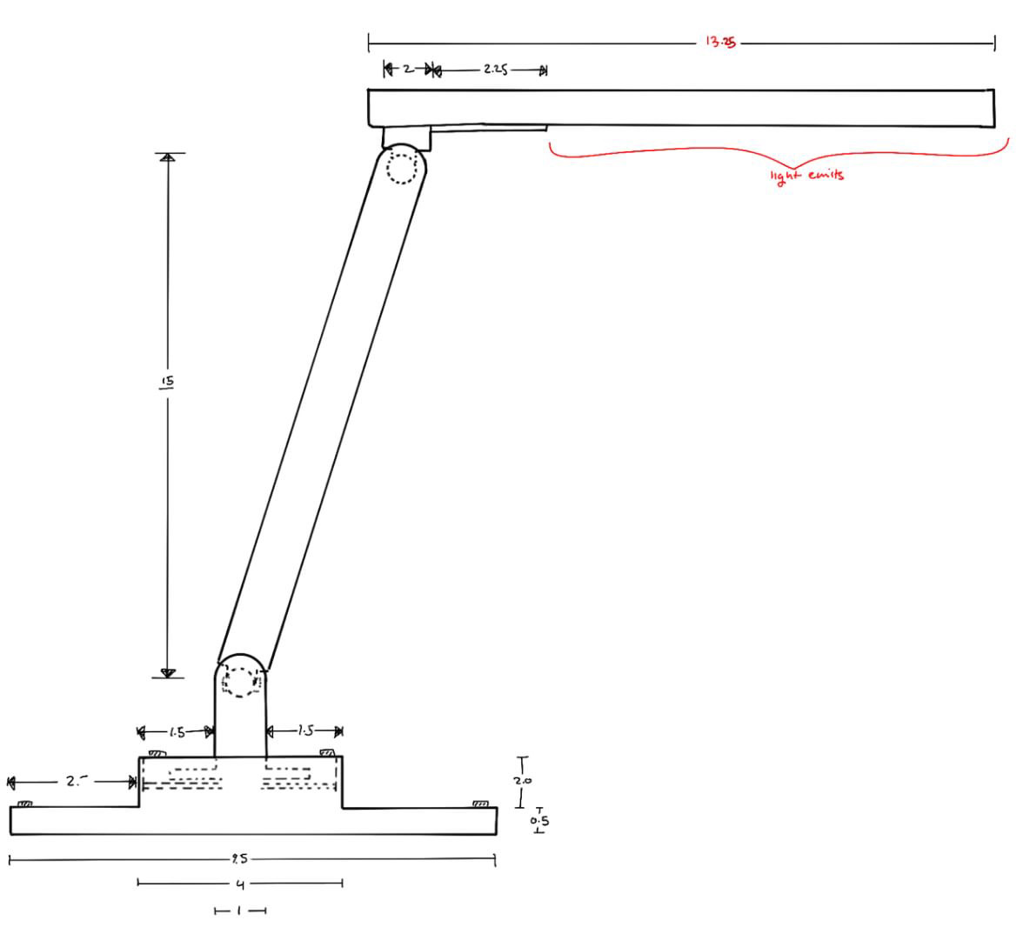
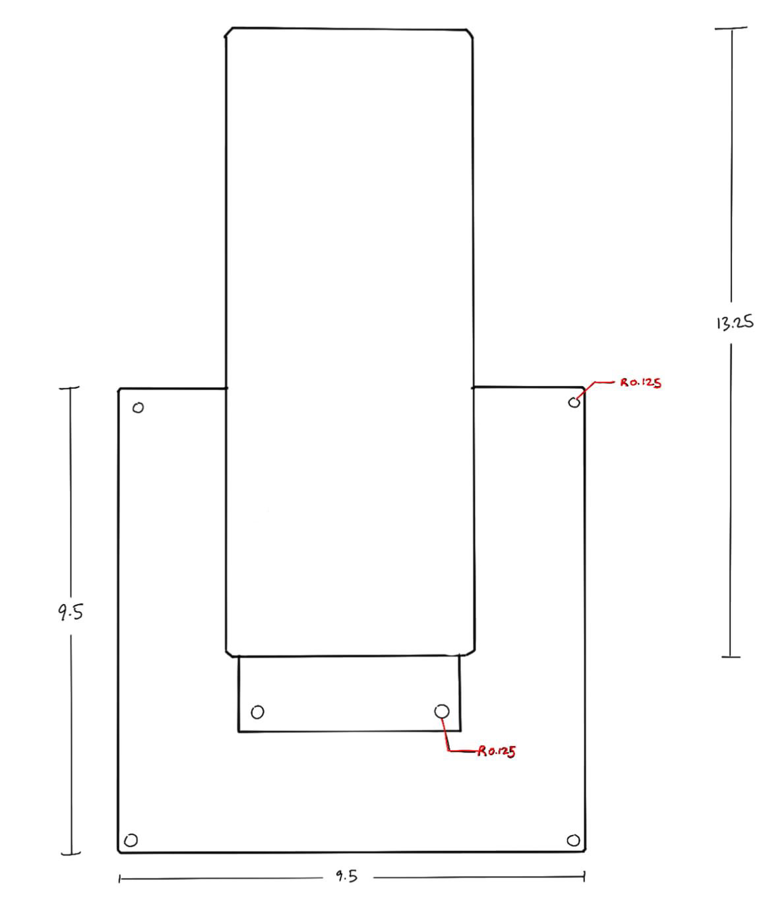
Sketch of our Final Product
Fig 3.2: Top view
Fig 3.0: Back view
Fig 3.1: Side view

Slide 10
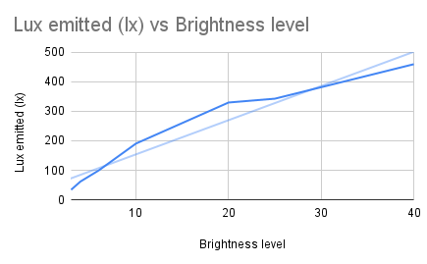
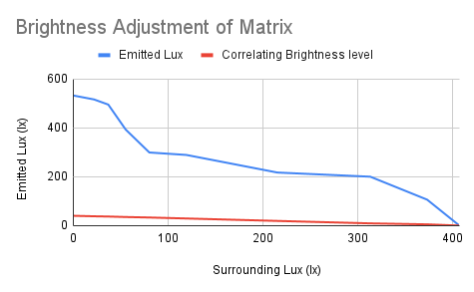
Results of Initial Tests- Self-Adjusting Brightness
Fig 4.0:
Test 1- Lux value vs brightness level for the LED Matrix.
The linear fit allows us to estimate what emitted lux should be in future tests.
Fig 4.1:
Test 2 -Measuring surrounding and emitted lux.
Inversely proportional relationship between surrounding and emitted lux/brightness level.
Notes:
Showed us that lamp can self adjust brightness!

Slide 11
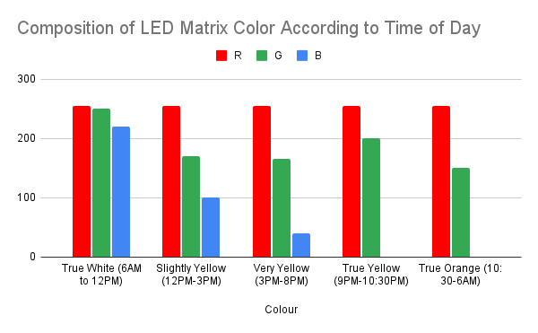
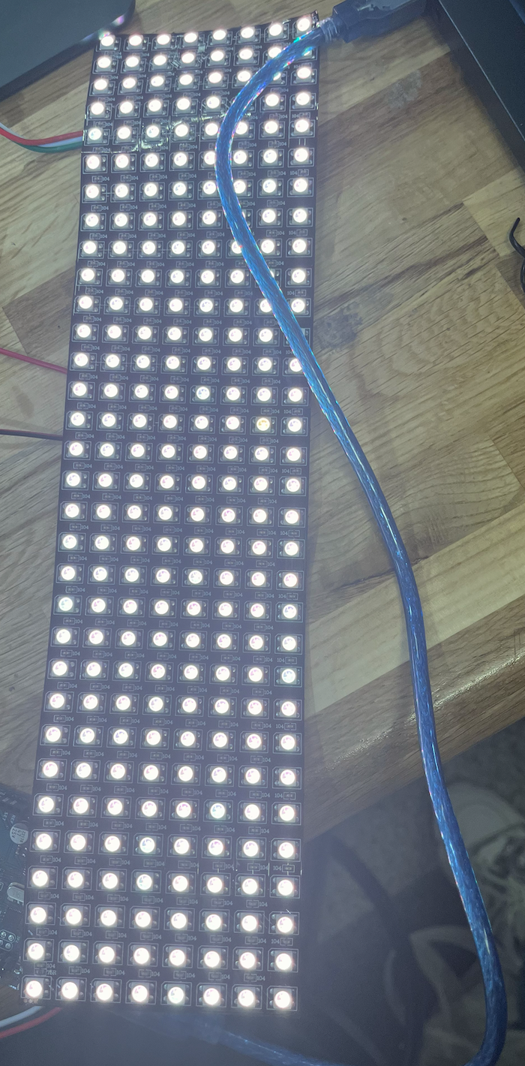
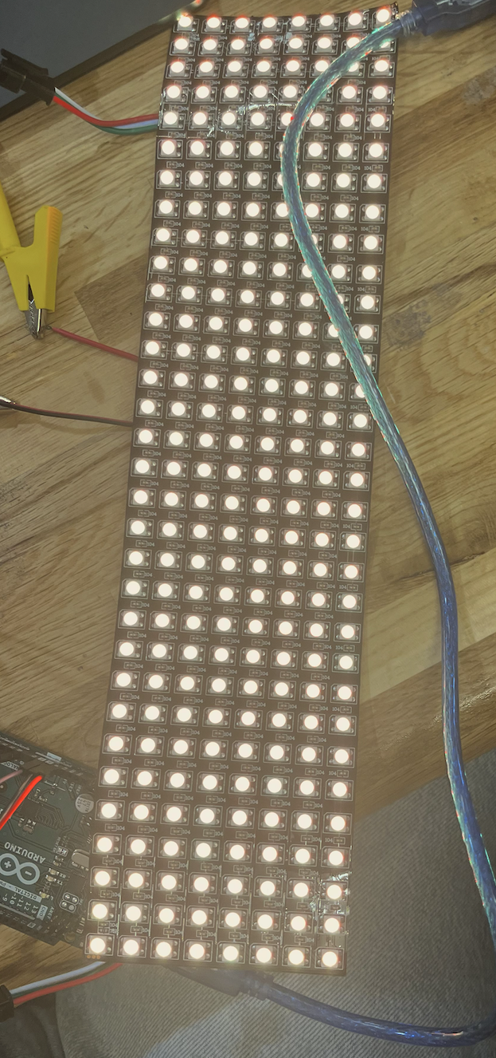
Results of Initial Tests- Self-Adjusting Wavelength
Fig 5.0: Decreasing blue light emitted during the night to regulate circadian rhythm.
Slightly yellow
Very yellow

Slide 12

Video Link:

Slide 13
Goals for upcoming weeks
01 | Circuit enclosure | Building an enclosure to contain our circuit. BH1750 on exterior of lamp.
02 | Final Wiring- Soldering | Seamless wiring with no breadboard.
03 | Housing | Final CAD, construction and assembly of parts.
04 | Diffusing Matrix Light | Less harsh on user.
05 | Integrating Safety Switch | Cutting power in case of emergency.
06 | Secondary Testing | Addressing issues that slipped past the preliminary tests.
07 | Final Testing/ Report | Final touches & assembly.

Slide 14
Q&A
Open to any questions or comments!
THANK YOU

